Slide 1
OOP in Scala: Traits and Abstract Classes
Presented by: Om parkash

Slide 2
Agenda
Why Scala OOP?
Traits: Definition & Example
Abstract Classes: Definition & Example
Key Differences & When to Use
Best Practices & Q&A

Slide 3
Introduction
Scala: A hybrid language blending object-oriented programming (OOP) and functional programming.
OOP in Scala: Supports classes, objects, inheritance, and polymorphism—similar to Java, but with unique twists like traits.
Why Traits and Abstract Classes?
Enable code reuse and abstraction.
Critical for designing modular, scalable systems.

Slide 4
Abstract Classes – Definition
Classes declared with abstract that cannot be instantiated.
May define both abstract and concrete methods/fields.
Can have constructor parameters.
Single inheritance (one abstract class).
Key Points:
Subclasses must implement all abstract members.
Useful for defining a base structure in a hierarchy.

Slide 5
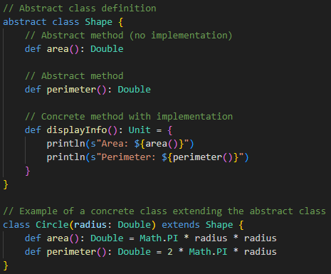
Abstract Classes – Example

Slide 6
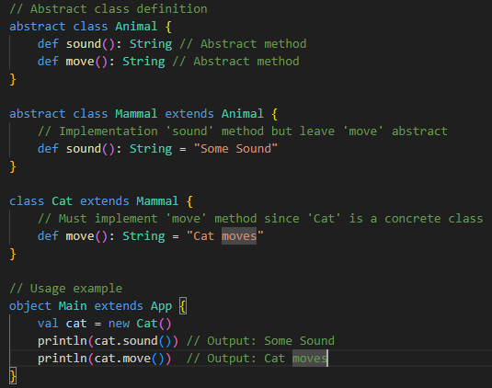
Abstract Classes Extending abstract class – Example

Slide 7
Scala Traits – Definition
A trait is like a Java interface with implemented methods
Defines behavior to be mixed into classes
Can contain abstract methods, concrete methods, and fields (val & var)

Slide 8
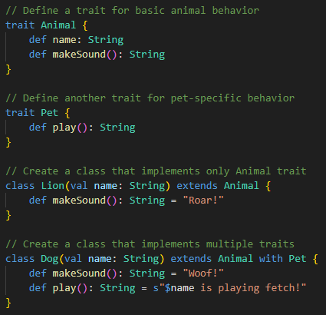
Scala Traits – Example

Slide 9
Traits vs. Abstract Classes
Aspect | Trait | Abstract Class
Multiple inheritance | Yes | No
Constructor parameters | No | Yes
Fields | Yes | Yes
JVM output | Interface + helper class | Class

Slide 10
When to Use Abstract Classes
Use when:
There’s a clear hierarchy (e.g., Shape → Circle, Rectangle).
Need constructor parameters.
Provide base class or common fields/methods.

Slide 11
When to Use Traits
Use when:
You want reusable behaviors (e.g., Logging, Auth, Caching).
A class needs features from multiple sources.
No need for constructor

Slide 12
Recap & Q&A
Abstract classes: Single inheritance, constructors, base logic.
Traits: Multiple inheritance, no constructors, flexibility, .
Key difference: Constructor parameters & inheritance model

Slide 13
Any questions?

Slide 14
Thank you!

